Slide 1
chapter 3 Linear regression

Slide 2
Linear regression has been around for a long time and is the topic of innumerable textbooks. Though it may seem somewhat dull compared to some of the more modern statistical learning approaches described in later chapters of this book, linear regression is still a useful and widely used statistical learning method. Moreover, it serves as a good jumping-off point for newer approaches: as we will see in later chapters, many fancy statistical learning approaches can be seen as generalizations or extensions of linear regression.

Slide 3
Recall the Advertising data
1. Is there a relationship between advertising budget and sales? 2. How strong is the relationship between advertising budget and sales? 3. Which media contribute to sales? 4. How accurately can we estimate the effect of each medium on sales? 5. How accurately can we predict future sales? 6. Is the relationship linear? 7. Is there synergy among the advertising media?

Slide 4
3.1 Simple Linear Regression
Simple linear regression lives up to its name: it is a very straightforward simple linear approach for predicting a quantitative response Y on the basis of a single predictor variable X.
You might read “≈” as “is approximately modeled as”.

Slide 5


3.1.1 Estimating the Coefficients
We define the residual sum of squares (RSS) as

Slide 6
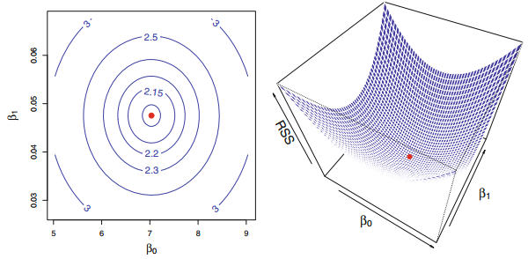

Slide 7


3.1.2 Assessing the Accuracy of the Coefficient Estimates
population regression line, which is the best linear approximation to the true relationship between X and Y .
The least squares regression coefficient estimates characterize the least squares line

Slide 8
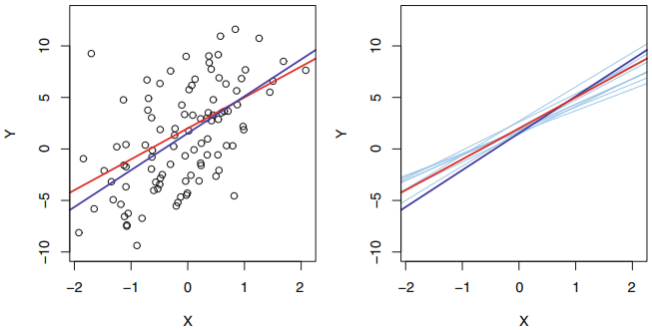

Slide 9
The true relationship is generally not known for real data, but the least squares line can always be computed using the coefficient estimates.
In other words, in real applications, we have access to a set of observations from which we can compute the least squares line; however, the population regression line is unobserved.

Slide 10
Unbiasedness
The property of unbiasedness holds for the least squares coefficient estimates : if we estimate β0 and β1 on the basis of a particular data set, then our estimates won’t be exactly equal to β0 and β1. But if we could average the estimates obtained over a huge number of data sets, then the average of these estimates would be spot on!

Slide 11


Variance
we can wonder how close β ˆ0 and β ˆ1 are to the true values β0 and β1.

Slide 12


For linear regression, the 95 % confidence interval for β1 approximately takes the form
Similarly, a confidence interval for β0 approximately takes the form

Slide 13


3.1.3 Assessing the Accuracy of the Model
Residual Standard Error
R2 Statistic

Slide 14

3.2 Multiple Linear Regression
Instead of fitting a separate simple linear regression model for each predictor, a better approach is to extend the simple linear regression model so that it can directly accommodate multiple predictors.
We can do this by giving each predictor a separate slope coefficient in a single model.

Slide 15

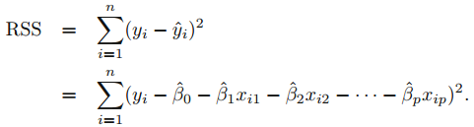
3.2.1 Estimating the Regression Coefficients

Slide 16
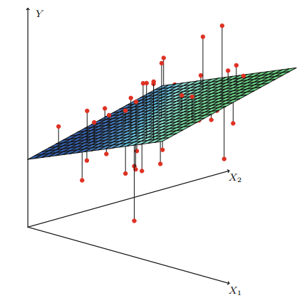

Slide 17
3.2.2 Some Important Questions
1. Is at least one of the predictors X1, X2, . . . , Xp useful in predicting the response?
2. Do all the predictors help to explain Y , or is only a subset of the predictors useful?
3. How well does the model fit the data?
4. Given a set of predictor values, what response value should we predict, and how accurate is our prediction?

Slide 18




One: Is There a Relationship Between the Response and Predictors?

Slide 19
Two: Deciding on Important Variables
We can then select the best model out of all of the models that we have considered. How do we determine which model is best? Various statistics can be used to judge the quality of a model. These include Mallow’s Cp, Akaike information criterion (AIC), Bayesian information criterion (BIC), and adjusted R2.
Forward selection. Backward selection. Mixed selection.

Slide 20

Three: Model Fit
Thus, models with more variables can have higher RSE if the decrease in RSS is small relative to the increase in p.

Slide 21
Four: Predictions
There are three sorts of uncertainty associated with this prediction
The inaccuracy in the coefficient estimates is related to the reducible error
There is an additional source of potentially reducible error which we call model bias.
We referred to this as the irreducible error. How much will Y vary from Y ˆ ? We use prediction intervals to answer this question.

Slide 22


3.3 Other Considerations in the Regression Model 3.3.1 Qualitative Predictors
Predictors with Only Two Levels

Slide 23



Qualitative Predictors with More than Two Levels

Slide 24



3.3.2 Extensions of the Linear Model
Removing the Additive Assumption

Slide 25
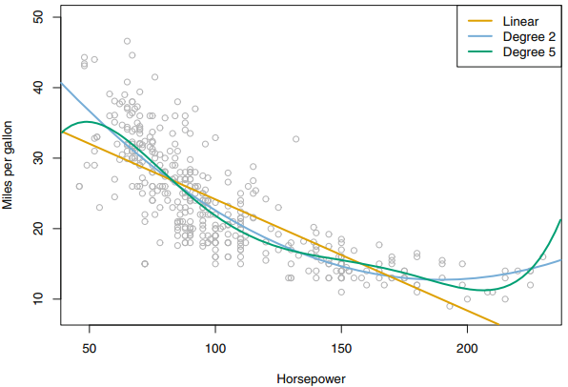
Non-linear Relationships

Slide 26
3.3.3 Potential Problems
1. Non-linearity of the response-predictor relationships.
2. Correlation of error terms.
3. Non-constant variance of error terms.
4. Outliers.
5. High-leverage points.
6. Collinearity.

Slide 27
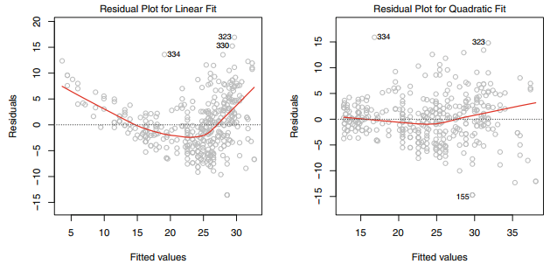
1. Non-linearity of the Data
If the residual plot indicates that there are non-linear associations in the data, then a simple approach is to use non-linear transformations of the predictors, such as log X, √X, and X2, in the regression model.

Slide 28
2. Correlation of Error Terms
if the errors are uncorrelated, then the fact that e(i) is positive provides little or no information about the sign of e(i+1). The standard errors that are computed for the estimated regression coefficients or the fitted values are based on the assumption of uncorrelated error terms. If in fact there is correlation among the error terms, then the estimated standard errors will tend to underestimate the true standard errors.

Slide 29
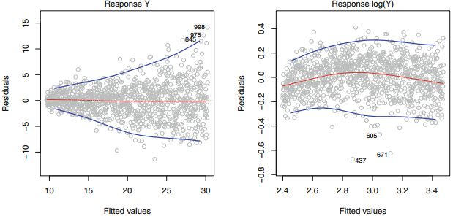
3. Non-constant Variance of Error Terms
One can identify non-constant variances in the errors, or heteroscedasticity, from the presence of a funnel shape in the residual plot.

Slide 30
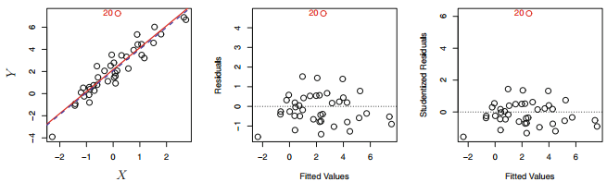
4. Outliers
An outlier is a point for which yi is far from the value predicted by the model. Outliers can arise for a variety of reasons, such as incorrect recording of an observation during data collection.

Slide 31

5. High Leverage Points
We just saw that outliers are observations for which the response yi is unusual given the predictor xi. In contrast, observations with high leverage high leverage have an unusual value for xi.

Slide 32

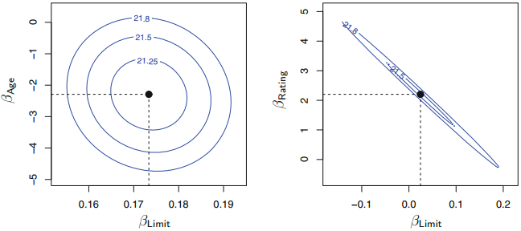
6. Collinearity

Slide 33
Code: Simple Linear Regression
library (MASS )
library (ISLR )
fix ( Boston )
names ( Boston )
lm.fit =lm(medv~lstat , data= Boston )
lm.fit
confint (lm.fit )
predict (lm.fit , data.frame ( lstat =(c(5 ,10 ,15) )), interval ="confidence")
predict (lm.fit , data.frame ( lstat =(c(5 ,10 ,15) )), interval ="prediction")

Slide 34
plot(lstat ,medv )
abline (lm.fit )
abline (lm.fit ,lwd =3)
abline (lm.fit ,lwd =3, col =" red ")
plot(lstat ,medv ,col =" red ")
plot(lstat ,medv ,pch =20)
plot(lstat ,medv ,pch ="+")
plot (1:20 ,1:20 , pch =1:20)

Slide 35
par ( mfrow =c(2 ,2) )
plot(lm.fit )
plot( predict (lm.fit ), residuals (lm.fit ))
plot( predict (lm.fit ), rstudent (lm.fit ))
plot( hatvalues (lm.fit ))
which.max ( hatvalues (lm.fit ))

Slide 36
Code: Multiple Linear Regression
lm.fit =lm(medv~lstat +age ,data= Boston )
summary (lm.fit )
lm.fit =lm(medv~.,data = Boston )
summary (lm.fit )
library (car )
vif (lm.fit )

Slide 37
Code : Interaction Terms and Non-linear Transformations of the Predictors
# Interaction Terms
summary (lm(medv~lstat *age ,data = Boston ))
# Non-linear Transformations of the Predictors
lm.fit=lm(medv~lstat +I( lstat ^2) )
summary (lm.fit)
lm.fit=lm(medv~poly(lstat ,5) )
summary (lm.fit )

Slide 38
Code : Qualitative Predictors
fix ( Carseats )
names ( Carseats )
lm.fit =lm(Sales~.+ Income : Advertising +Price :Age , data= Carseats )
summary (lm.fit )

